Slide 1
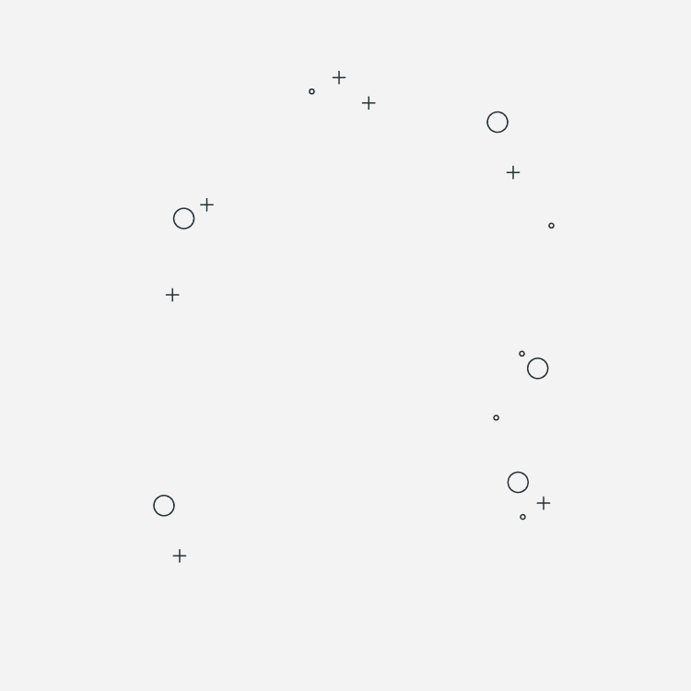

APPLICATIONDESIGN
RENT IT

Slide 2
GUIDE
01. USER STORY
05. USE CASE DIAGRAM
03. CLASS DIAGRAM

Slide 3
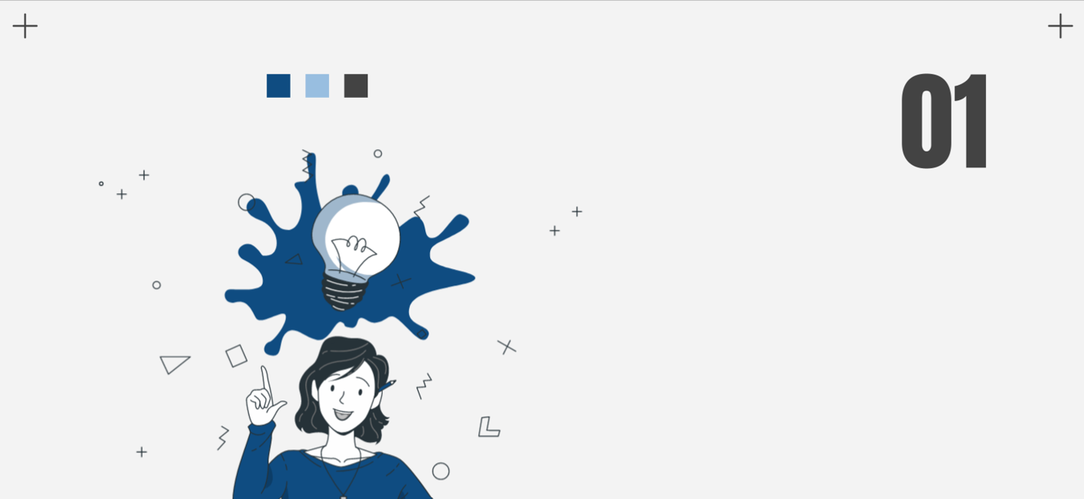
USER
STOTRY

Slide 4
USERS LIST
ADMIN
RENTER
CLIENT

Slide 5

USERS
ADMIN
Have acess to all anounces and can monitor all
Client
Want to rent a house
Renter
Want his house to be rented

Slide 6
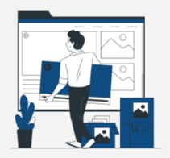
ADMIN
The admin is th monitor of all in my app.
First, he have to login through an interface specified for admins , then he access to a dashboard where all users are listed, he can delete any unwanted user .
Acess to all anounces and see them in a card .
He should be able also to delete an announce if it doesn’t meet the requirments.

Slide 7
RENTER
If the renter already have an account he chooses the interface of login , if not he should register first then login.
He get redirected to the renter interface , he should be able to add a new announce , view the interessed people with his house that he want to rent , edit an existing announce, report to the admin if he face a problem.

Slide 8

CLIENT
If the client already have an account he chooses the interface of login , if not he should register first then login.
The client should be able to consult announces, see different informations about the houses .

Slide 9

02
USE CASE DIAGRAM

Slide 10
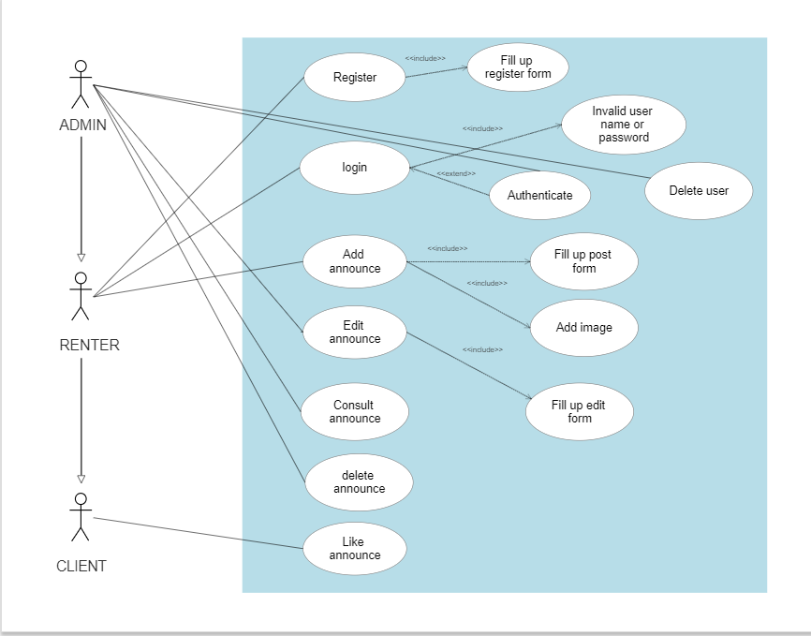

Slide 11

03
CLASS DIAGRAM

Slide 12
